Slide 1
Introduction to Machine learning
.

Slide 2
Agenda
Machine learning basic
Machine learning features
Machine learning process
Types of machine learning
Machine learning algorithms
Use cases

Slide 3
Definition of machine learning
Machine learning is a branch of artificial intelligence (AI) and computer science which focuses on the use of data and algorithms to imitate the way that humans learn, gradually improving its accuracy.
Machine learning (ML) is a type of artificial intelligence (AI) that allows software applications to become more accurate at predicting outcomes without being explicitly programmed to do so. Machine learning algorithms use historical data as input to predict new output values.

Slide 4
Need for machine learning
Ever since the technical revolution, we’ve been generating an immeasurable amount of data. As per research, we generate around 2.5 quintillion bytes of data every single day! It is estimated that by 2020, 1.7MB of data will be created every second for every person on earth.
With the availability of so much data, it is finally possible to build predictive models that can study and analyze complex data to find useful insights and deliver more accurate results
Top Tier companies such as Netflix and Amazon build such Machine Learning models by using tons of data in order to identify profitable opportunities and avoid unwanted risks.

Slide 5
Why Machine learning
Increase in Data Generation: Due to excessive production of data, we need a method that can be used to structure, analyze and draw useful insights from data. This is where Machine Learning comes in. It uses data to solve problems and find solutions to the most complex tasks faced by organizations.
Improve Decision Making: By making use of various algorithms, Machine Learning can be used to make better business decisions. For example, Machine Learning is used to forecast sales, predict downfalls in the stock market, identify risks and anomalies, etc.
Uncover patterns & trends in data: Finding hidden patterns and extracting key insights from data is the most essential part of Machine Learning. By building predictive models and using statistical techniques, Machine Learning allows you to dig beneath the surface and explore the data at a minute scale. Understanding data and extracting patterns manually will take days, whereas Machine Learning algorithms can perform such computations in less than a second.

Slide 6
Machine learning applications
Netflix’s Recommendation Engine: The core of Netflix is its infamous recommendation engine. Over 75% of what you watch is recommended by Netflix and these recommendations are made by implementing Machine Learning.
Facebook’s Auto-tagging feature: The logic behind Facebook’s DeepMind face verification system is Machine Learning and Neural Networks. DeepMind studies the facial features in an image to tag your friends and family.
Amazon’s Alexa: The infamous Alexa, which is based on Natural Language Processing and Machine Learning is an advanced level Virtual Assistant that does more than just play songs on your playlist. It can book you an Uber, connect with the other IoT devices at home, track your health, etc.
Google’s Spam Filter: Gmail makes use of Machine Learning to filter out spam messages. It uses Machine Learning algorithms and Natural Language Processing to analyze emails in real-time and classify them as either spam or non-spam.

Slide 7
Machine learning process
The Machine Learning process involves building a Predictive model that can be used to find a solution for a Problem Statement. To understand the Machine Learning process let’s assume that you have been given a problem that needs to be solved by using Machine Learning.
Problem :- The problem is to predict the occurrence of rain in your local area by using Machine Learning.

Slide 8
Step 1 Problem statement
At this step, we must understand what exactly needs to be predicted. In our case, the objective is to predict the possibility of rain by studying weather conditions. At this stage, it is also essential to take mental notes on what kind of data can be used to solve this problem or the type of approach you must follow to get to the solution.

Slide 9
Step 2 Data Gathering
At this stage, you must be asking questions such as,
What kind of data is needed to solve this problem?
Is the data available?
How can I get the data?
Once you know the types of data that is required, you must understand how you can derive this data. Data collection can be done manually or by web scraping.

Slide 10
Step 3 Data Preparation
The data you collected is almost never in the right format. You will encounter a lot of inconsistencies in the data set such as missing values, redundant variables, duplicate values, etc. Removing such inconsistencies is very essential because they might lead to wrongful computations and predictions. Therefore, at this stage, you scan the data set for any inconsistencies and you fix them then and there.

Slide 11
Step 4 Data analysis
Data Exploration involves understanding the patterns and trends in the data. At this stage, all the useful insights are drawn and correlations between the variables are understood.
For example, in the case of predicting rainfall, we know that there is a strong possibility of rain if the temperature has fallen low. Such correlations must be understood and mapped at this stage.

Slide 12
Step 5 Building a ML model
All the insights and patterns derived during Data Analysis are used to build the Machine Learning Model.
This stage always begins by splitting the data set into two parts, training data, and testing data.
In the case of predicting rainfall, since the output will be in the form of True (if it will rain tomorrow) or False (no rain tomorrow), we can use a Classification Algorithm such as Logistic Regression.

Slide 13
Step 6 Model evaluation and Optimization
After building a model by using the training data set, it is finally time to put the model to a test. The testing data set is used to check the efficiency of the model and how accurately it can predict the outcome. Once the accuracy is calculated, any further improvements in the model can be implemented at this stage. Methods like parameter tuning and cross-validation can be used to improve the performance of the model.

Slide 14
Step 7 Predictions
Once the model is evaluated and improved, it is finally used to make predictions. The final output can be a Categorical variable (eg. True or False) or it can be a Continuous Quantity (eg. the predicted value of a stock).

Slide 15
Types of Machine learning
Supervised Learning
Unsupervised Learning
Reinforcement Learning

Slide 16
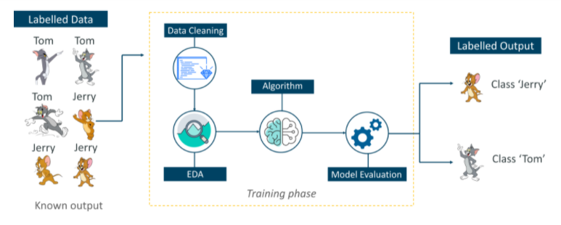
Supervised learning
Supervised learning is a technique in which we teach or train the machine using data which is well labeled.

Slide 17
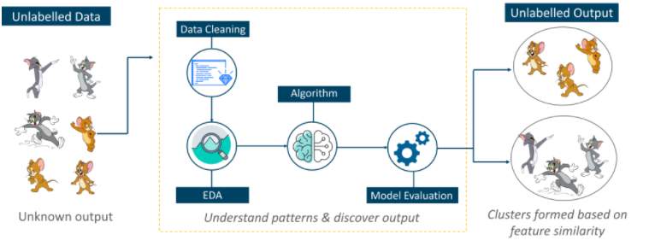
Unsupervised learning
Unsupervised learning involves training by using unlabeled data and allowing the model to act on that information without guidance.

Slide 18
Reinforcement learning
Reinforcement Learning is a part of Machine learning where an agent is put in an environment and he learns to behave in this environment by performing certain actions and observing the rewards which it gets from those actions.

Slide 19
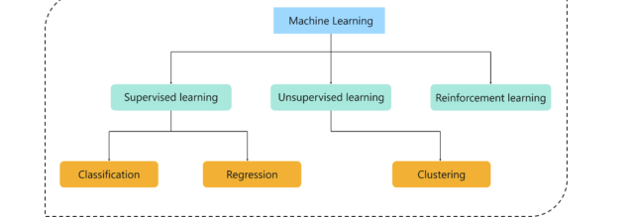
Machine learning types

Slide 20
Regression
In this type of problem the output is a continuous quantity. So, for example, if you want to predict the speed of a car given the distance, it is a Regression problem. Regression problems can be solved by using Supervised Learning algorithms like Linear Regression.

Slide 21
Classification
In this type, the output is a categorical value. Classifying emails into two classes, spam and non-spam is a classification problem that can be solved by using Supervised Learning classification algorithms such as Support Vector Machines, Naive Bayes, Logistic Regression, K Nearest Neighbor, etc.

Slide 22
Clustering
This type of problem involves assigning the input into two or more clusters based on feature similarity. For example, clustering viewers into similar groups based on their interests, age, geography, etc can be done by using Unsupervised Learning algorithms like K-Means Clustering.

Slide 23
Machine learning algorithms
Linear Regression
Logistic Regression
Decision Tree
Naive Bayes
kNN

Slide 24
Linear regression
It is used to estimate real values (cost of houses, number of calls, total sales etc.) based on continuous variables.
we establish a relationship between the independent and dependent variables by fitting the best line.
This best fit line is known as the regression line and represented by a linear equation Y= aX + b.

Slide 25
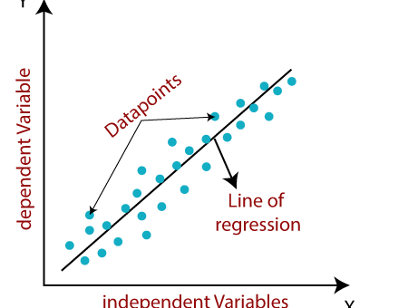
Linear regression
The linear regression model provides a sloped straight line representing the relationship between the variables.

Slide 26
Finding the best fit line
When working with linear regression, our main goal is to find the best fit line that means the error between predicted values and actual values should be minimized. The best fit line will have the least error.
The different values for weights or the coefficient of lines (a₀, a₁) gives a different line of regression, so we need to calculate the best values for a₀ and a₁ to find the best fit line, so to calculate this we use cost function.

Slide 27
Cost function
The different values for weights or coefficient of lines (a₀, a₁) gives the different line of regression, and the cost function is used to estimate the values of the coefficient for the best fit line.
Cost function optimizes the regression coefficients or weights. It measures how a linear regression model is performing.
We can use the cost function to find the accuracy of the mapping function, which maps the input variable to the output variable. This mapping function is also known as Hypothesis function.

Slide 28

Mean squared error
For Linear Regression, we use the Mean Squared Error (MSE) cost function, which is the average of squared error occurred between the predicted values and actual values. It can be written as:

Slide 29
Logistic Regression
Logistic regression is one of the most popular Machine Learning algorithms, which comes under the Supervised Learning technique. It is used for predicting the categorical dependent variable using a given set of independent variables.
Logistic regression predicts the output of a categorical dependent variable. Therefore the outcome must be a categorical or discrete value. It can be either Yes or No, 0 or 1, true or False, etc. but instead of giving the exact value as 0 and 1, it gives the probabilistic values which lie between 0 and 1.

Slide 30
Logistic Regression
Logistic Regression is much similar to the Linear Regression except that how they are used. Linear Regression is used for solving Regression problems, whereas Logistic regression is used for solving the classification problems.
In Logistic regression, instead of fitting a regression line, we fit an "S" shaped logistic function, which predicts two maximum values (0 or 1).
The curve from the logistic function indicates the likelihood of something such as whether the cells are cancerous or not, a mouse is obese or not based on its weight, etc.
Logistic Regression is a significant machine learning algorithm because it has the ability to provide probabilities and classify new data using continuous and discrete datasets.

Slide 31
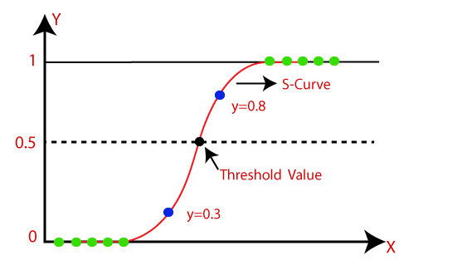
Logistic regression

Slide 32
Sigmoid function
The sigmoid function is a mathematical function used to map the predicted values to probabilities.
It maps any real value into another value within a range of 0 and 1.
The value of the logistic regression must be between 0 and 1, which cannot go beyond this limit, so it forms a curve like the "S" form. The S-form curve is called the Sigmoid function or the logistic function.
In logistic regression, we use the concept of the threshold value, which defines the probability of either 0 or 1. Such as values above the threshold value tends to 1, and a value below the threshold values tends to 0.

Slide 33
Decision tree
Decision Tree is a Supervised learning technique that can be used for both classification and Regression problems, but mostly it is preferred for solving Classification problems. It is a tree-structured classifier, where internal nodes represent the features of a dataset, branches represent the decision rules and each leaf node represents the outcome.
In a Decision tree, there are two nodes, which are the Decision Node and Leaf Node. Decision nodes are used to make any decision and have multiple branches, whereas Leaf nodes are the output of those decisions and do not contain any further branches.

Slide 34
Decision tree
The decisions or the test are performed on the basis of features of the given dataset.
It is a graphical representation for getting all the possible solutions to a problem/decision based on given conditions.
It is called a decision tree because, similar to a tree, it starts with the root node, which expands on further branches and constructs a tree-like structure.
In order to build a tree, we use the CART algorithm, which stands for Classification and Regression Tree algorithm.

Slide 35

Decision tree

Slide 36
Decision tree terminologies
Root Node: Root node is from where the decision tree starts. It represents the entire dataset, which further gets divided into two or more homogeneous sets.
Leaf Node: Leaf nodes are the final output node, and the tree cannot be segregated further after getting a leaf node.
Splitting: Splitting is the process of dividing the decision node/root node into sub-nodes according to the given conditions.

Slide 37
Decision tree algorithm
In a decision tree, for predicting the class of the given dataset, the algorithm starts from the root node of the tree. This algorithm compares the values of root attribute with the record (real dataset) attribute and, based on the comparison, follows the branch and jumps to the next node.
For the next node, the algorithm again compares the attribute value with the other sub-nodes and move further. It continues the process until it reaches the leaf node of the tree.

Slide 38
Complete process
Step-1: Begin the tree with the root node, says S, which contains the complete dataset.
Step-2: Find the best attribute in the dataset using Attribute Selection Measure (ASM).
Step-3: Divide the S into subsets that contains possible values for the best attributes.
Step-4: Generate the decision tree node, which contains the best attribute.
Step-5: Recursively make new decision trees using the subsets of the dataset created in step -3. Continue this process until a stage is reached where you cannot further classify the nodes and called the final node as a leaf node.

Slide 39
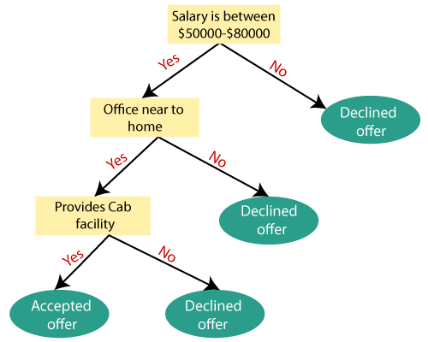
Decision tree Example

Slide 40
Attribute selection measure
While implementing a Decision tree, the main issue arises that how to select the best attribute for the root node and for sub-nodes. So, to solve such problems there is a technique which is called as Attribute selection measure or ASM. By this measurement, we can easily select the best attribute for the nodes of the tree. There are two popular techniques for ASM, which are:
1) Information gain
2) Gini Index

Slide 41
Information gain
Information gain is the measurement of changes in entropy after the segmentation of a dataset based on an attribute.
It calculates how much information a feature provides us about a class.
According to the value of information gain, we split the node and build the decision tree.
A decision tree algorithm always tries to maximize the value of information gain, and a node/attribute having the highest information gain is split first. It can be calculated using the below formula:
Information Gain= Entropy(S)- [(Weighted Avg) *Entropy(each feature)

Slide 42
Entropy
Entropy is a metric to measure the impurity in a given attribute. It specifies randomness in data. Entropy can be calculated as:
Entropy(s)= -P(yes)log2 P(yes)- P(no) log2 P(no)
Where,
S= Total number of samples
P(yes)= probability of yes
P(no)= probability of no

Slide 43

Gini Index
Gini index is a measure of impurity or purity used while creating a decision tree in the CART(Classification and Regression Tree) algorithm.
An attribute with the low Gini index should be preferred as compared to the high Gini index.
It only creates binary splits, and the CART algorithm uses the Gini index to create binary splits.

Slide 44
Random forest algorithm
Random Forest is a popular machine learning algorithm that belongs to the supervised learning technique. It can be used for both Classification and Regression problems in ML. It is based on the concept of ensemble learning, which is a process of combining multiple classifiers to solve a complex problem and to improve the performance of the model.
As the name suggests, "Random Forest is a classifier that contains a number of decision trees on various subsets of the given dataset and takes the average to improve the predictive accuracy of that dataset." Instead of relying on one decision tree, the random forest takes the prediction from each tree and based on the majority votes of predictions, and it predicts the final output.

Slide 45
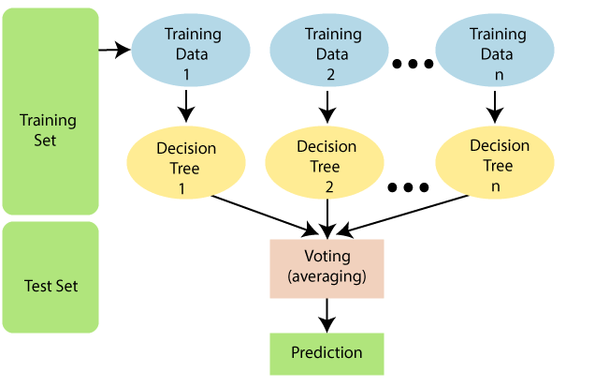
Random forest algorithm
.

Slide 46
How random forest algorithm works ?
Random Forest works in two-phase first is to create the random forest by combining N decision tree, and second is to make predictions for each tree created in the first phase.
The Working process can be explained in the below steps and diagram:
Step-1: Select random K data points from the training set.
Step-2: Build the decision trees associated with the selected data points (Subsets).
Step-3: Choose the number N for decision trees that you want to build.
Step-4: Repeat Step 1 & 2.
Step-5: For new data points, find the predictions of each decision tree, and assign the new data points to the category that wins the majority votes.

